Slide 1
BERT: Pre-training of Deep Bidirectional Transformers for Language Understanding
19/04/17
Jacob Devlin, Ming-Wei Chang, Kenton Lee, Kristina Toutanova
NAACL’2019

Slide 2
Motivation
Better language representation model
Use Bidirectional Transformer for feature learning
Notes:
We’ll likely see more approaches experimenting not only in the way the input should be processed, but also how the output should be produced by a model. Some of these might be closer to the way humans write text—for instance by starting with a main message or a sketch and then iteratively expanding it on—and might enable novel interactive applications.

Slide 3
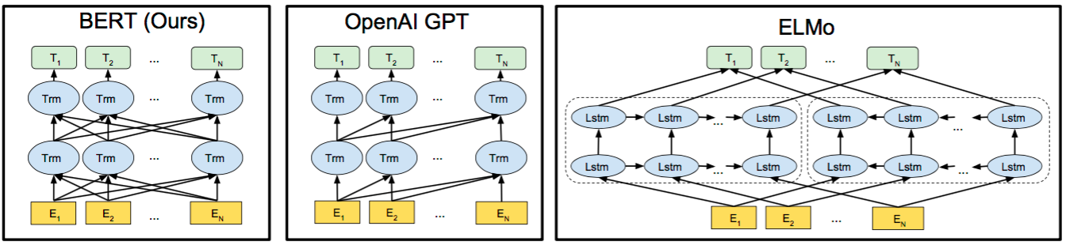
Motivation
Better language representation model
Use Bidirectional Transformer for feature learning
Notes:
We’ll likely see more approaches experimenting not only in the way the input should be processed, but also how the output should be produced by a model. Some of these might be closer to the way humans write text—for instance by starting with a main message or a sketch and then iteratively expanding it on—and might enable novel interactive applications.

Slide 4
Motivation
Better language representation model
Use Bidirectional Transformer for feature learning
Unidirectional
LSTM
Notes:
We’ll likely see more approaches experimenting not only in the way the input should be processed, but also how the output should be produced by a model. Some of these might be closer to the way humans write text—for instance by starting with a main message or a sketch and then iteratively expanding it on—and might enable novel interactive applications.

Slide 5
Pre-training
Input Representation
Notes:
We’ll likely see more approaches experimenting not only in the way the input should be processed, but also how the output should be produced by a model. Some of these might be closer to the way humans write text—for instance by starting with a main message or a sketch and then iteratively expanding it on—and might enable novel interactive applications.

Slide 6
Pre-training
Input Representation
Notes:
We’ll likely see more approaches experimenting not only in the way the input should be processed, but also how the output should be produced by a model. Some of these might be closer to the way humans write text—for instance by starting with a main message or a sketch and then iteratively expanding it on—and might enable novel interactive applications.

Slide 7
Pre-training
Embeddings
token embeddings
segment embeddings
position embeddings
Notes:
We’ll likely see more approaches experimenting not only in the way the input should be processed, but also how the output should be produced by a model. Some of these might be closer to the way humans write text—for instance by starting with a main message or a sketch and then iteratively expanding it on—and might enable novel interactive applications.

Slide 8
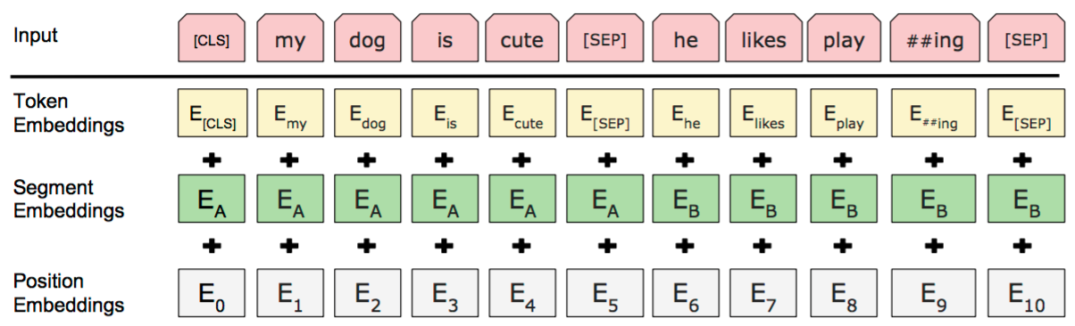
Pre-training
Input Representation
for each token
Notes:
We’ll likely see more approaches experimenting not only in the way the input should be processed, but also how the output should be produced by a model. Some of these might be closer to the way humans write text—for instance by starting with a main message or a sketch and then iteratively expanding it on—and might enable novel interactive applications.

Slide 9
Pre-training
Task 1: Masked Language Model
Predicts the mask tokens
Notes:
Adding a classification layer on top of the encoder output.
Multiplying the output vectors by the embedding matrix, transforming them into the vocabulary dimension.
Calculating the probability of each word in the vocabulary with softmax.

Slide 10
Pre-training
Task 2: Next Sentence Prediction
Predicts if the second sentence in the pair is the subsequent sentence in the original document.
Processing for the input sentence pair
Notes:
A [CLS] token is inserted at the beginning of the first sentence and a [SEP] token is inserted at the end of each sentence.
A sentence embedding indicating Sentence A or Sentence B is added to each token. Sentence embeddings are similar in concept to token embeddings with a vocabulary of 2.
A positional embedding is added to each token to indicate its position in the sequence. The concept and implementation of positional embedding are presented in the Transformer paper.

Slide 11
Pre-training
Task 2: Next Sentence Prediction
Predicts if the second sentence in the pair is the subsequent sentence in the original document.
The entire input sequence goes through the Transformer model.
The output of the [CLS] token is transformed into a 2 x 1 shaped vector, using a simple classification layer.
Calculating the probability with softmax.
Notes:
A [CLS] token is inserted at the beginning of the first sentence and a [SEP] token is inserted at the end of each sentence.
A sentence embedding indicating Sentence A or Sentence B is added to each token. Sentence embeddings are similar in concept to token embeddings with a vocabulary of 2.
A positional embedding is added to each token to indicate its position in the sequence. The concept and implementation of positional embedding are presented in the Transformer paper.

Slide 12
Fine-tuning
BERT can be used for a wide variety of language tasks, while only adding a small layer to the core model.
Notes:
We’ll likely see more approaches experimenting not only in the way the input should be processed, but also how the output should be produced by a model. Some of these might be closer to the way humans write text—for instance by starting with a main message or a sketch and then iteratively expanding it on—and might enable novel interactive applications.

Slide 13
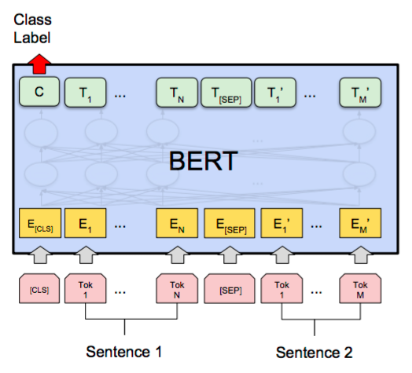
Fine-tuning
Classification tasks are done similarly to
Next Sentence Prediction, by adding a
classification layer on top of the Transformer output for the CLS token.
Classification
Notes:
We’ll likely see more approaches experimenting not only in the way the input should be processed, but also how the output should be produced by a model. Some of these might be closer to the way humans write text—for instance by starting with a main message or a sketch and then iteratively expanding it on—and might enable novel interactive applications.

Slide 14
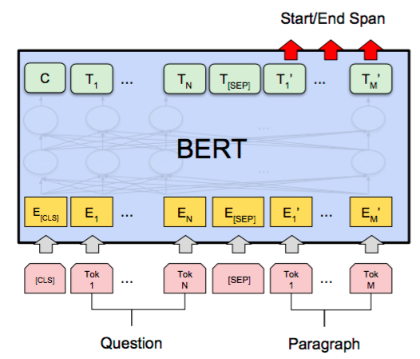
Fine-tuning
In Question Answering tasks, the software receives a question regarding a text sequence and is required to mark the answer in the sequence. Using BERT, a model can be trained by learning two extra vectors that mark the beginning and the end of the answer.
Q & A
Notes:
We’ll likely see more approaches experimenting not only in the way the input should be processed, but also how the output should be produced by a model. Some of these might be closer to the way humans write text—for instance by starting with a main message or a sketch and then iteratively expanding it on—and might enable novel interactive applications.

Slide 15
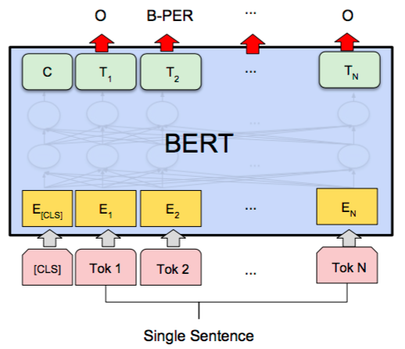
Fine-tuning
In tagging tasks such as NER, a model can be trained by feeding the output vector of each token into a classification layer that predicts the NER label.
Tagging
Notes:
We’ll likely see more approaches experimenting not only in the way the input should be processed, but also how the output should be produced by a model. Some of these might be closer to the way humans write text—for instance by starting with a main message or a sketch and then iteratively expanding it on—and might enable novel interactive applications.

Slide 16
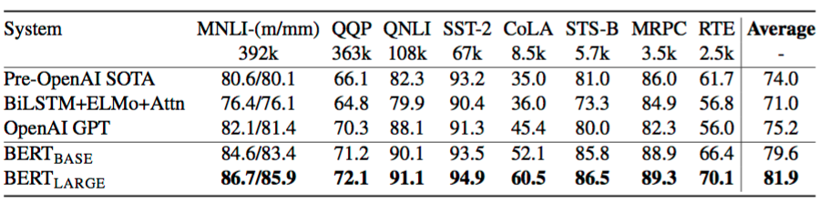
Experiments
BERT vs. OpenAI GPT
Bidirectional vs. Unidirectional
BERT vs. ELMO
Transformer vs. LSTM

Slide 17
Conclusion
Empirical results are strong.
Transformer outperforms LSTM/RNN/CNN on feature learning in NLP.
BERT’s bidirectional approach converges slower than left-to-right approach but bidirectional training still outperforms left-to-right training after a small number of pre-training steps.

Slide 18
Q & A

